Slide 1
Obtaining and Implementing Medicaid Administrative Federal Financial Participation (FFP) for Aging and Disability Resource Centers (ADRCs) in Hawaii and Maryland
Hawaii Executive Office on Aging- Caroline Cadirao, Debbie Shimizu
Maryland Department of Aging- Ami Patel
Maryland Department of Health and Mental Hygiene- Devon Mayer
Administration for Community Living- Joseph Lugo
HCBS Strategies, Inc.- Steven Lutzky, Andrew Cieslinski

Slide 2
Joseph Lugo
Administration for Community Living
Slide 2

Slide 3
Agenda
Overview of FFP and why it should be pursued
Overview of FFP infrastructure
Discussion of Maryland’s FFP infrastructure
Hawaii’s adaptation of Maryland’s infrastructure
Role that ACL can play in supporting FFP effort
Questions and comments
Slide 3

Slide 4
Presenters
Hawaii Executive Office on Aging
Caroline Cadirao, Grants Chief
Debbie Shimizu, ADRC Network Lead
Maryland Department of Aging
Ami Patel, ADRC Operations Specialist
Maryland Department of Health and Mental Hygiene
Devon Mayer, Former Money Follows the Person Project Director
Administration for Community Living
Joseph Lugo, Team Lead for the Office of Consumer Access and Self-Determination
HCBS Strategies, Inc.
Steve Lutzky, President
Andrew Cieslinski, Associate
Slide 4

Slide 5
Key Elements of a NWD System of Access to LTSS for All Populations and Payers
https://www.medicaid.gov/medicaid-chip-program-information/by-topics/financing-and-reimbursement/no-wrong-door.html
Slide 5
Notes:
Seamless system from consumer perspective
High level of visibility and trust
Proactive intervention into LTSS pathways
Integration of aging and disability service systems
Formal partnerships across aging, disability and Medicaid
All income levels served
Coordination and transformation of existing access functions across multiple organizations serving all populations and all payers

Slide 6
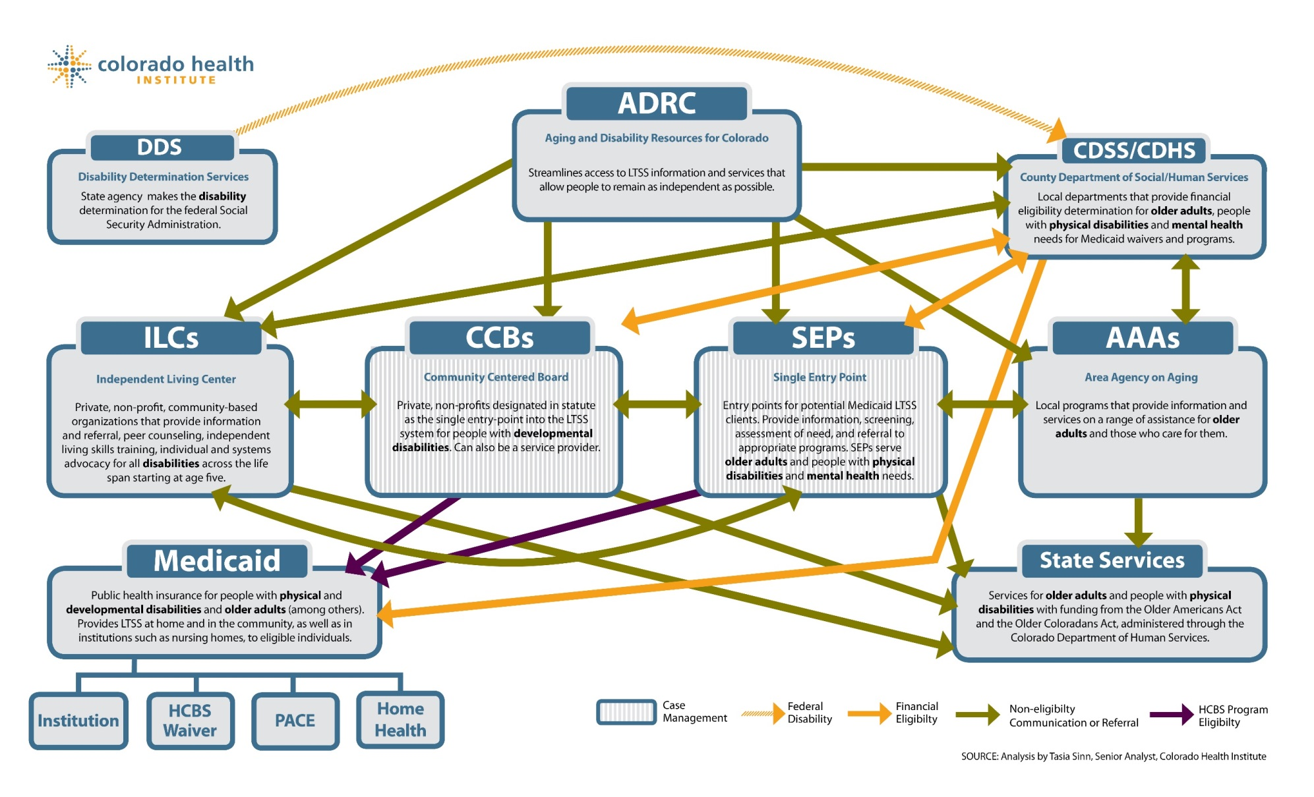
The LTSS Puzzle
Notes:
CO Department of Health Care Policy & Financing (Presenting TA Webinar)
In Colorado, they recently conducted an assessment of their access system.
From the state perspective and mapped out the numerous eligibility functions and organizations conducting these activities
They also looked from the consumer perspective and mapped out the numerous entry points (varying in capacity) that consumers can access
CO was able to capture the need for increased efficiency as well as improving the consumer experience

Slide 7
Institutional and Home and Community-Based Services (HCBS) as a Percentage of Long-Term Services and Supports (LTSS), FFY 1995-2014
Notes:
The percentage of total LTSS spent on home and community-based services (HCBS) increased from 51.3 percent in FY 2013 to 53.1 percent in FY 2014, continuing a decades-long trend of relative growth in HCBS.

Slide 8
Steven Lutzky
HCBS Strategies
Slide 8

Slide 9
Overview of FFP
Slide 9

Slide 10
FFP Overview
FFP provides matching dollars (generally 50%) to cover activities that contribute to the efficient and effective administration of the Medicaid program
Many ADRC functions are potentially eligible for matching Medicaid administrative funds
FFP can provide an ongoing, sustainable source of funding for enhanced ADRC activities
Note: It is likely other agencies in your state already claim administrative FFP and they may be able to provide technical support

Slide 11
Activities Reimbursed Under FFP
Potentially Medicaid related activities include:
Outreach and enrollment
Case management
Provider monitoring
Planning and development
Network development
Auditing
Quality improvement

Slide 12
Why Should ADRCs Pursue FFP?
Ongoing source of funding:
Once approved, funding will continue
FFP covers about 38% of costs for Wisconsin (i.e., 76% of activities are claimable)
Strengthens the case for State and local funding:
Local money goes twice as far
Demonstrates that the ADRC is a core infrastructure supporting the Medicaid program
This funding becomes the backbone for securing additional revenue sources:
Medicaid Choice Counseling, health plans, private pay, etc.
Does not require major changes to regular operations
Staff are already doing the work!

Slide 13
Devon Mayer
Formerly with the Maryland Department of Health and Mental Hygiene (Maryland’s Medicaid agency)
Slide 13

Slide 14
What’s in it for Medicaid?
Medicaid, Medicaid, Medicaid!
Why does Medicaid get all the attention?!
Minimize duplication from having multiple entities facilitating access to Medicaid
Reduce Medicaid costs by delaying or preventing Medicaid eligibility
Triage may reduce unnecessary assessments
Supports Person-centered planning
*Photo created by Teja Rau from MDoA
Slide 14

Slide 15
Overview of FFP Infrastructure
Slide 15

Slide 16
Key Components of FFP Claiming Infrastructure
Document Medicaid Related Time
Establish Costs for Staff Time
Agreements and Approvals
FFP Claiming
Slide 16

Slide 17
FFP Claiming and Reimbursement Process- Once Implemented
Add all participating staff into “cost pool”
Run time studies to capture staff time
Local sites submit quarterly spreadsheet with actual expenditures
Operating agency calculates % time Medicaid and reimburses local sites
Operating agency requests reimbursement from Medicaid agency
Slide 17

Slide 18
Andrew Cieslinski
HCBS Strategies
Slide 18

Slide 19
Development Process
Who
What
When
How
Slide 19

Slide 20
Development Timeline
DEVELOP AND TEST CODES
MEDICAID MOU
Medicaid
SUBMITS PACKET TO CMS
CMS APPROVAL
4-6 months
2-3 months
1 month
3-6 months
Slide 20

Slide 21
Documenting Medicaid Related Time- Time Study Codes
Establish codes to classify how staff time is spent:
Medicaid related
Not Medicaid related
General Administration
Codes should both:
Appear similar to what CMS has seen in previous approved applications
Make sense to the workers who need to code their time

Slide 22
Develop and Test Task Codes
Purpose: To ensure task definitions and codes are comprehensive and understandable.
Brainstorm with local staff about their daily tasks
Include management, administrative, and clerical tasks
Have front-line staff pilot test the codes
Convene staff focus group to provide feedback on definitions and whether all types of tasks were captured.
Slide 22

Slide 23
Documenting Medicaid Related Time- Infrastructure Development
Decide methodology for collecting information on staff time
Random moment
Daily log/timesheet
Alternative approaches (e.g., 100% documentation for only a portion of the days)
Develop infrastructure for implementing methodology
Establish training and monitoring infrastructure
Conduct pilots to establish whether code descriptions are clear to local staff and cost estimates

Slide 24
Establishing Cost of Staff Time
All costs for staff participating in time study on a quarterly basis
Costs for staff supporting staff participating in time study
Align cost categories with OMB guidance and state practices
Mechanism for reporting costs (e.g., standardized excel spreadsheet)
Work with local sites to complete reporting mechanism accurately
State review of reports
Slide 24

Slide 25
Identify Relevant Cost Categories
Purpose: To identify all costs that support ADRC/NWD staff time, activities, and operations.
Identify and define costs using cost categories similar to State chart of accounts.
Develop spreadsheet/invoice using cost categories
Understand what types of costs are disallowed or not agreed upon by Medicaid (e.g. food).
Review and pilot test spreadsheet/invoice with local fiscal staff to ensure they understand the process and task categories.
Slide 25

Slide 26
Example: Reimbursable Costs in Maryland
Salaries
Fringe and Benefits
Indirect
Travel
Vehicle costs
Training
Phone/telecom
Postage
Printing
Association dues
Software
Equipment and maintenance
Contractual services (e.g. audit, accounting)
Outreach
Slide 26

Slide 27
Agreements and Approvals
CMS
Medicaid agency
Operating agency
Local sites
Likely Chain of Agreements:
MOU between Single State Medicaid agency and operating agency
Will be incorporated into Cost Allocation Plan
CMS will need to approve the amended plan
Slide 27
Slide 27

Slide 28
Relationships Across Agencies
Slide 28

Slide 29
State Unit Responsibilities
Run time studies
Gather cost spreadsheets
Ensure appropriate staff are participating in time studies
Provide quarterly invoice to Medicaid for reimbursement
Disburse reimbursements to local sites
Quality assurance and compliance – fiscal & program
Training, fiscal reviews, time sample reviews
Slide 29

Slide 30
Local Agency Responsibilities
Ensure all appropriate staff performing reimbursable activities are participating in the time study
Fiscal spreadsheets include all non-federal dollars allocated to supporting reimbursable tasks and staff
Review and establish intake and triage workflows
Attend trainings and participate in time studies
Submit timely fiscal spreadsheets
Slide 30

Slide 31
Ami Patel
Maryland Department of Aging
Slide 31

Slide 32
Discussion of Maryland’s FFP Infrastructure
Slide 32

Slide 33
Development of Time Study Infrastructure
MDoA worked with HCBS Strategies, local agencies, and the Medicaid office to establish codes that reflect all activities performed by staff in Maryland
These codes were piloted using both the random moment and daily log methodology. This initial pilot served two purposes:
Test the codes to determine if they reflected all staff activities
Determine which methodology to use for the ongoing time study; random moment selected
Slide 33

Slide 34
Development of Time Study Infrastructure (cont.)
MDoA then conducted three additional random moment pilots (using SurveyMonkey) with the revised codes to obtain claiming estimates and provide practice for local staff
Why three pilots!?
Goal was to ensure staff are familiar with the coding process before officially implementing FFP claiming
Gives MAP sites an idea of workflow and where to make improvements to maximize the Medicaid %
Slide 34

Slide 35
Time Study Overview
Maryland uses a random moment methodology
Staff code activity at a randomly selected time
Number of samples varies depending upon # of staff and other objectives (e.g., entity-specific estimates, use as part of quality improvement, etc.)
Pros: Less burdensome, more accurate reporting; CMS more comfortable with this approach
Cons: Need to purchase special software or set up randomization, which can be time consuming
Slide 35

Slide 36
Time Study Overview (cont.)
Using a web-based RMTS software system (via contract with vendor)
Automatically generates the samples each quarter
Sends daily “response needed lists” to local MAP Director with list of missing samples
Validations and Quality Assurance – allows MAP Director to confirm or deny a small number of employee’s responses
Reports available in real-time
Slide 36

Slide 37
Time Study Codes in Maryland
Outreach and program education
Includes activities that help inform people about programs that provide long term supports and services (LTSS) and other services. Includes both targeted outreach to specific individuals and broader outreach to the general population.
Facilitating applications
Includes activities related to assisting individuals or families with the application process for LTSS, health care services, and other supports that may assist an individual with remaining in the community (e.g., income supports, energy assistance, etc.).
Referral, coordination, and monitoring of services
Applies to staff activities that include making referrals to, coordinating, and/or monitoring the delivery of specific LTSS or other health care services. This code refers to specific services or supports; applications to programs should be coded under Facilitating Applications.
Slide 37

Slide 38
Time Study Codes in Maryland (cont.)
Training
Applies to coordinating, conducting, or participating in training and seminars regarding LTSS, health care services, and other supports that may assist an individual with remaining in the community (e.g. income supports, energy assistance, etc.).
Program Administration
Includes activities related to establishing and maintaining documentation, internal processes, and policies related to the provision of LTSS, health care services, and other supports that may assist an individual to remain in the community (e.g., income supports, energy assistance, etc.), as well as working with other partner agencies to improve the coordination and delivery of services, and performing collaborative activities with other agencies to provide services.
Level 1 Screen
Includes all activities related to performing a Level I Screen.
Slide 38

Slide 39
Time Study Codes in Maryland (cont.)
MAP Options Counseling (excludes people in nursing facilities)
Options Counseling (OC) is defined as and in-depth conversation that supports an individual and/or the individual’s representative to make an informed choice about their goals and preferences and which Long Term Supports and Services (LTSS) option is the best fit for that person. (Typically complete an Action Plan.)
General administration
Use for activities including paid time off, break, vacation, general supervision, processing payroll, etc.
Other
Slide 39

Slide 40
Establishing Cost of Staff Time- Cost Pool Overview
Maryland uses a Cost Pool Spreadsheet, developed as team with HCBS Strategies, to record staff costs
Cost pool must capture actual total costs for each worker included in cost pool and at least 50% state or local contribution towards the total costs
Include costs for staff that support these workers (e.g., Execs, admins, fiscal staff, etc.)
Total overall costs are then multiplied by % time Medicaid (from time study reports) to calculate claim
MDoA then aggregates this data using Excel to establish the State Quarterly Claim (amount of reimbursement for Statewide Medicaid claimable %)
Ensure each MAP site has sufficient match
Slide 40

Slide 41
Preparing for Day 1 of Claiming – Staff Training and Ongoing Monitoring
Staff trainings
Training should have lots of examples and scenarios, not just code definitions
Timely changes to staff pool
Bi-weekly “Quizzes” to keep code definitions fresh for staff
Ensures accuracy in coding
Slide 41

Slide 42
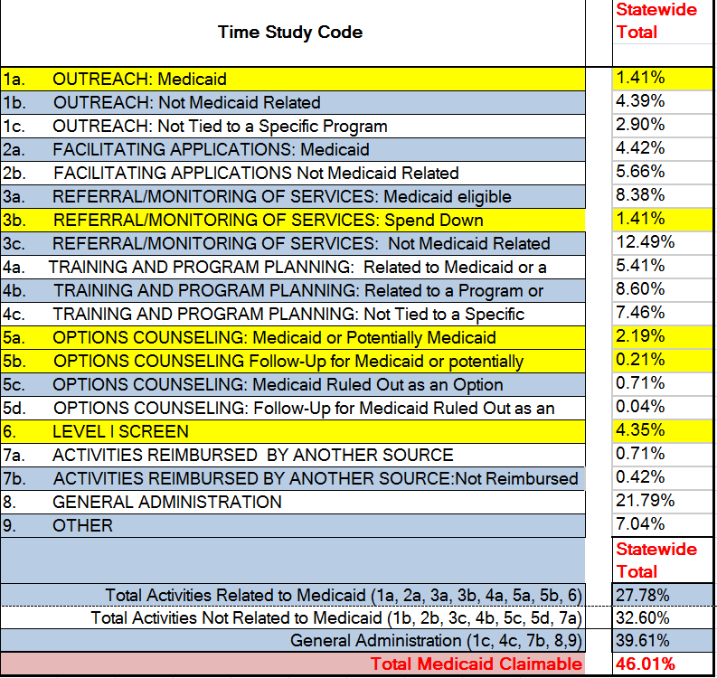
FY16 4th Quarter Claim
3000 samples generated
150 staff total
Only 3 samples missing at end of quarter!
Statewide Medicaid Claimable % = 46.01%
First FFP Claim = $667,532
Slide 42

Slide 43
Ongoing Work: Fiscal
Time-to-Matching-Dollars Ratios:
Un-invested
Under-invested and over-worked
Over-invested and under-worked
Best value
Slide 43

Slide 44
Maryland’s Innovations in Developing Time Study
Adapted codes that correspond to staff work
Level 1 Screen
Options Counseling – Potentially Medicaid
Claiming for time spent working with individuals at risk of institutionalization and becoming eligible for Medicaid
Senior Care staff and coordination with local DSS staff
Slide 44

Slide 45
Debbie Shimizu
Hawaii Executive Office on Aging
Slide 45

Slide 46
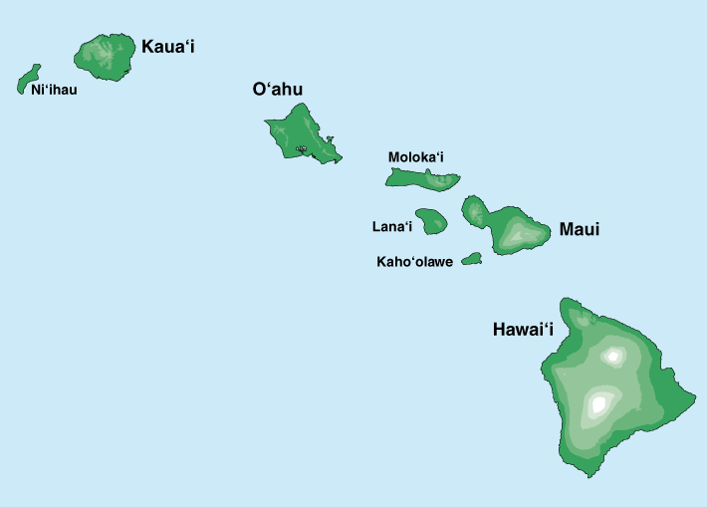
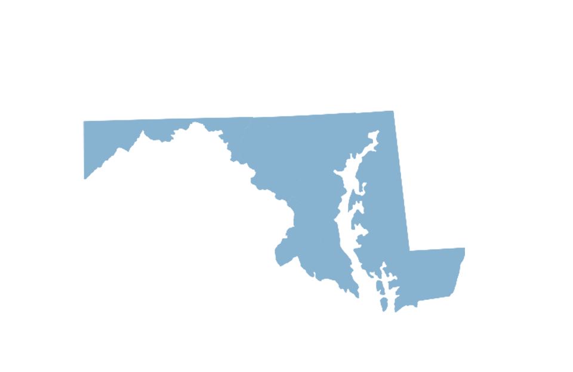
Hawaii’s Adaptation of Maryland’s Infrastructure
Slide 46

Slide 47
Adaptations Hawaii Made to the Maryland Approach
TIME STUDY CODES
EOA and AAA staff reviewed MD’s codes and approved the following changes to reflect current and planned operations:
Eliminated options counseling code
Added codes that reflect intake and assessment process
Added a placeholder for a potential future ADRC service, Medicaid managed care Choice Counseling
Slide 47
Notes:
Nalani

Slide 48
Hawaii’s codes are ordered to make choice of code clearer
1. Reimbursed by another source
3. Call Log/Intake
4. Facilitating Program Applications
6. Referral, Coordination, & Monitoring
7. Outreach
8. Training or Program Admin.
9. General Admin.
10. Other
2. Medicaid Choice Counseling
5. Assessment/Support Plan Development
Slide 48

Slide 49
Adaptations Hawaii Made to the Maryland Approach (cont.)
COST POOL SPREADSHEET
Adapted cost pool spreadsheet to reflect Hawaii’s accounting guidance
Added claim for work done by contractors, notably the case management entities
Identified WHO will be responsible to complete the spreadsheet
Slide 49

Slide 50
Caroline Cadirao
Hawaii Executive Office on Aging
Slide 50

Slide 51
Hawaii Time Study Pilot
Hawaii conducted two time study pilots with the four county ADRCs using the random moment methodology
The initial pilot tested the code language and refinements that needed to be made to reflect staff activities
Then conducted a follow-up pilot with the revised codes to obtain claiming estimates
Given the scale of the Hawaii effort, SurveyMonkey will likely be used for the ongoing time study
Now working with the State Medicaid agency, MQD, to move forward with ongoing claiming process
Slide 51

Slide 52
Hawaii Time Study Pilot Results- Claimable Time
Slide 52

Slide 53
Hawaii Time Study Pilot Results- Amount of Medicaid Claim
County | Quarterly FFP Claim | Annual FFP Claim
Hawai'i | $70,704 | $282,817
Honolulu | $106,181 | $424,724
Kauai | $38,004 | $152,016
Maui | $124,500 | $498,001
State Total | $339,388 | $1,357,554
Slide 53

Slide 54
Helpful Hints
Talk with other states to learn from their experiences
Early collaboration between State and local staff and preliminary mini-pilots can improve the accuracy of codes and need for further refinement
Provide thorough training and develop mechanism for answering ongoing questions
Set realistic goals for data collection and time study duration
Smaller agencies may need more time to gather data
Don’t over complicate!! Staff are already performing tasks; not looking to change day to day operations
Collect complete costs for staff participating in FFP claiming (e.g., rent, utilities, etc.)
The greater the associated costs, the higher the return
Slide 54

Slide 55
Joseph Lugo
Administration for Community Living
Slide 55

Slide 56
Role that ACL Can Play in Supporting FFP Efforts
Slide 56

Slide 57
A State Scorecard on Long-Term Services and Supports for Older Adults, People with Physical Disabilities, and Family Caregivers
List of 26 Indicators Across 5 Domains in a State Scorecard on LTSS
Affordability and Access
Choice of Setting and Provider
Quality of Life and Quality of Care
Support for Family Caregivers
Effective Transitions
Slide 57

Slide 58
ACL Support Behind the Scenes
Targeted Webinars/Training
CMS Central & Regional Offices
State Medicaid Agencies
Aging & Disability Network Providing NWD System Functions
ACL Technical Assistance & Support
ACL Central/Regional Office TA
Email: NoWrongDoor@acl.hhs.gov
Slide 58

Slide 59
Questions?
Slide 59

Slide 60
Presenter Contact Information
Maryland Department of Aging
Ami Patel, ADRC Operations Specialist ami.patel@maryland.gov 410.767.1088
Hawaii Executive Office on Aging
Caroline Cadirao, Grants Chief caroline.cadirao@doh.hawaii.gov 808.586.7297 Debbie Shimizu, ADRC Network Lead debra.shimizu@doh.hawaii.gov 808.586.0100
Maryland Department Health and Mental Hygiene
Devon Mayer dmayer@neweditions.net
HCBS Strategies, Inc.
Steven Lutzky, President steve@hcbs.info 410.366.4227 Andrew Cieslinski, Associate andrew@hcbs.info 734.431.4977
Administration for Community Living
Joseph Lugo, Team Lead, Office of Consumer Access and Self-Determination NoWrongDoor@acl.hhs.gov 202.795.7391
Slide 60

