Slide 1
Moving Towards Reliable and Valid Assessment Processes In
Alaska and Colorado
Presentation for the 2017 HCBS Conference

Slide 2
Agenda and Speakers
Key issues in redesigning assessment and support planning, including reliability and validity
  Steve Lutzky, President, HCBS Strategies
Colorado and Alaska initiatives to redesign their assessment and support planning processes
  Colorado Department of Health Care Policy and Finance:
    Tim Cortez, Manager, Community Options Section
    Brittani Trujillo, Case Management Services Coordinator, Office of Community Living
  Alaska Department of Health and Social Services:
    Duane Mayes, Director, Division of Seniors and Disabilities Services

Slide 3
Steve Lutzky
HCBS Strategies

Slide 4
Most Frequently Forgotten Truth about Assessment Processes
Collect information
Make Decisions

Slide 5
Best Approach for Designing Assessment & Support Planning Process
Clarify Decisions
ID Info Needed to Support Decisions
Design Assessment Process

Slide 6
Types of Decisions Assessment Helps to Make
What should be in the Support Plan?
Last slide has suggestions (will review if we have time)
Process and plan person-centered?
Eligible?
Complying with rules?
Are supports working?
How much money?

Slide 7
Assessment Process vs. Tool
Assessment process will support a series of decisions made by a number of individuals
Includes tools or modules that support these decisions and collect necessary information
Also includes decision trees and workflows

Slide 8
Example of Work Flow

Slide 9
Understanding Reliability and Validity

Slide 10
Reliability and Validity of Assessment Items
If we use the same item twice on the same person and nothing has changed, will we get the same results?
Are we studying what we think we are studying?

Slide 11
Reliability of the Item
Extent to which an assessment item yields the same results on repeated trials
  Test-Retest reliability: collect same data at two times and measure correlation between two results
  Inter-rater reliability: collect same data by two people at same time and measure correlation or % of agreement
  Internal consistency: measure correlation across similar items within test using Cronbach’s alpha

Slide 12
Validity of the Item
Does the item measure what you think it is measuring?
  Face Validity: subjective judgment by “non-expert”
  Content Validity: subjective judgment by subject matter experts
  Criterion Validity: predictive validity between 2 variables or correlation with “gold standard” (factor analysis)
  Construct Validity: theory-based predictive modeling of practical examples
    Convergent : similar results when comparing similar concepts
    Divergent: distinguishes between different concepts

Slide 13
Value of Using Standardized Items
Capitalize on existing evidence-based items with known reliability and validity
Compare your state’s HCBS to:
  Other states HCBS
  Institutional care
Enhance operations using tools and protocols developed for other states or countries using standardized data:
  Individualize budgets/resource allocation (e.g., RUG-III-HC)
  Protocols for guiding support planning and/or care management (e.g., Clinical Action Plans or Collaborative Active Plans (CAPs))
  Normed Quality/Performance Indicators

Slide 14
Reliability and Validity Challenges Found in Home Grown Tools

Slide 15
Why Poorly Constructed Assessment Items Can Undermine a System
Difference across assessors that get amplified over time
  In the absence of clear guidance, assessors come up with their own interpretations
  Leads to regional discrepancies
Increases opportunities for assessment creep and assessor shopping
Diminishes the ability to make reliable financial and policy choices

Slide 16
Challenge 1: Items assess need for support rather than underlying impairments, strengths and preferences
Assess impairments, preferences and strengths
Try to measure as objectively as possible
Identify support needs
Involves judgement and balancing of multiple concerns (e.g., independence vs. safety)
Determine how to provide supports
Involves reconciling available resources, preferences, regulatory limitations, etc.
Items that Merge these Steps are problematic
Should have same outcome every time
Some variance in outcomes based on relationships and beliefs
Greater variance because of relationship/beliefs and different capabilities, resources, etc. of CM

Slide 17
Examples of Problematic Items
Does the individual need support to describe pain, signs of illness or where it is located?
  Answers will vary depending upon how assessor chooses to factor in:
    Presence of pain
    Verbal/cognitive abilities
    Whether pain is significant enough to justify an intervention
    Personality/culture
  Examples of opportunities for unreliable coding. How do you code:
    Someone who has no pain, but is non-verbal and cannot report pain if it occurs?
    Someone who has pain but prefers to be stoic?
    Someone who appears to have pain and cannot report it, but the pain appears to be mild and only occasional – assessor makes a judgement call regarding whether this is significant enough to justify additional support

Slide 18
Challenge 2: Items Potentially Confound Multiple Underlying Issues
An item is problematic if assessors need to make sub-judgements about multiple different areas
  Reliability issue because answers may differ depending upon what areas they consider and what weight they give to each area
  Validity issue because it is not clear what is being measured
Example: Does the individual need support to add items to cart/basket, make choices from available options, load/unload groceries?
  Confounds:
    Physical ability (add items to cart/basket)
    Cognitive ability (determine what needs to be purchased)
    Behavior (making inappropriate choices)

Slide 19
Challenge 3: Item Language Construction
Even when measuring a single construct, problematic items may hurt ability to code consistently (reliability) and interpret what the responses mean (validity)
Inexact or unclear prompts :
  Not including enough relevant information (e.g., does bathing include getting in and out of the tub or shower?)
Inexact or unclear response options
Example: Does the individual need support to get in or out of vehicles?
  Response Options: Never, Always, Often, 1/2 Time, Sometimes
    Does not measure amount of support needed
    Options include two vague measures (often and sometimes) and one that is overly specific (½ time)
    Question whether item might typically be a yes/no, possibly with an intermittent option

Slide 20
Designing a New Assessment Process for All LTSS Populations
The Perspective and Lessons Learned from Colorado
Tim Cortez and Brittani Trujillo

Slide 21
HCPF Mission

Slide 22
Current Assessment Tools
The current tools used to assess LTSS populations include:
  ULTC 100.2
    Home-grown tool
  SIS for IDD populations
    Standardized, nationally used tool
  Over 30 supplemental tools created by Department and local staff to support access processes
Assessment and access processes vary significantly across populations and programs
22

Slide 23
Limitations to Legacy Tools
ULTC 100.2
  No set timeframes (e.g., in last 30 days)
  Definitions and responses are vague and overlapping
  Collects very little information outside of ADLs
    Limited use when developing support plan
SIS
  Requires agency staff to be specially trained on tool and pay for training/tool
  Some stakeholders unhappy with the use of the SIS: length of time to complete; concerns that it doesn’t capture enough information; concerns about the use for development of Support Levels

Slide 24
Limitations to Legacy Tools (cont.)
Local agencies have developed 30+ non-standardized tools to collect missing information from legacy tools
Other issues with tools include:
  No person-centered information
  No natural support and caregiver information
  No screen of other areas of interest/need (e.g., employment, self-direction)
  Very limited information that is useful for support planning

Slide 25
Stakeholder Input into the Development of the Process
Stakeholder input during development of the intake and assessment tools included:
  Input from community members and staff from over 15 agencies
  21 stakeholder meetings on adult assessment tool
  8 stakeholder meetings on child assessment tool
Stakeholders were presented with a variety of national and state-specific tools
  interRAI
  CMS’ CARE (now FASI)
  MnCHOICES
  Washington’s CARE
Notes:
Advocacy groups and individuals with disabilities strongly represented in this group

Slide 26
Stakeholder Input into the Development of the Process (cont.)
Developed a blog to share information and collect feedback: Colorado Assessment Blog
Made major changes to the modules and process as a result of stakeholder input
Now conducting meetings throughout state to share progress and gather feedback
Notes:
Advocacy groups and individuals with disabilities strongly represented in this group

Slide 27

Tools Selected as Starting Point for the Assessment Process
After careful review, Department and stakeholders decided to use components of the following tools:
  CMS’ CARE tool (Later changed to FASI)
    Standardized items throughout the tool (e.g., functioning, health, etc.)
  Minnesota’s MnCHOICES comprehensive assessment
    Modular format would serve as basis for CO process
    Person-centered items and modules (e.g., Personal Story)
    Items CARE/FASI did not contain (e.g., Psychosocial/Behaviors)

Slide 28
Approach for Developing the New Assessment Process
Understand current LTSS assessment process
Identify how processes can be improved (redesign goals and outcomes)
Identify existing tools to be included in the new assessment process
Customize the tools to meet Colorado’s needs
Pilots for components of the process
Adapt process for children
Develop plans for Person-centered Support Plan, automation, full-scale testing, and statewide implementation

Slide 29
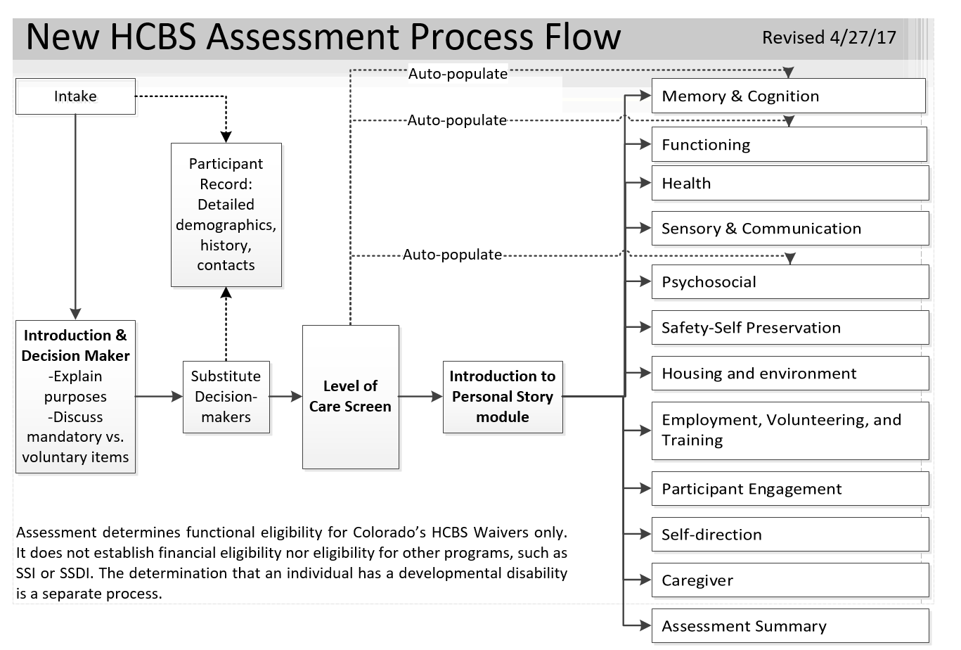
Notes:
The Redesign process includes the Intake Screen and 14 modules
Two assessment pathways depending upon whether a SIS assessment is needed

Slide 30
Testing the New Approach
The assessment process will be tested as part of a larger TEFT pilot effort:
  Alpha testing- User acceptance
    Summer 2018
  Beta testing- Comprehensive pilot
    Fall 2018
Upon the conclusion of Beta testing, will conduct analyses to:
  Establish and improve reliability and validity
  Refine tool contents, flow, and automation

Slide 31
Testing the New Approach (cont.)
After the Alpha and Beta testing, Department will run pilot to test time it takes to complete process
  Pilot staff will be familiar with tool, providing realistic estimate
Results of this pilot will inform updates to case management reimbursement structure
Buy-in and volume from pilots will inform rollout approach

Slide 32
Other LTSS Systems Changes New Assessment Process will Support
More person-centered system
More informed choice about self-direction
Restructuring case management including being able to tailor amount and type to participant preferences and needs
Foster competitive employment
Support emerging separation of eligibility assessment vs. support planning and ongoing case management

Slide 33
Other LTSS Systems Changes New Assessment will Support (cont.)
Objective and empirically-based person-centered budgets
  Give people more choice and control over services
  Allows expansion of consumer directed principles to other services
Enhance quality management efforts, including quality of life/participant experience data

Slide 34
Questions?
34

Slide 35
Contact Information
Tim Cortez
Manager, Community Options Section
timothy.cortez@state.co.us
Brittani Trujillo
Case Management Services Coordinator
brittani.trujillo@state.co.us

Slide 36
Thank You!

Slide 37

State of Alaska
Division of Senior and Disabilities Services
Assessment Process Redesign
37

Slide 38
Duane Mayes, Director
Alaska Department of Health and Social Services
Division of Senior and Disabilities Services
38

Slide 39
Current Assessment Tools
Alaska’s current LTSS assessment tools include:
  Consumer Assessment Tool (CAT) for all adult waivers, excluding IDD, and Personal Care Services (PCS)
    Home-grown tool
  ICAP for IDD waiver
    Standardized, nationally used tool
Assessment and access processes vary significantly across populations and programs
39
Notes:
As we go forward, we need to evaluate our processes again and include new policy and procedure and tools. Need a system and enough support staff to effect change quickly.

Slide 40
Limitations of the Legacy Tools
Limitations include:
  Lack of person-centered information that can be used to inform goals and preferences
  Lack of established reliability and validity within the CAT
  Issues with using tools to justify individual budgets
  Do not comply with CMS person-centered and settings requirements
  participants may need to receive two assessments depending on service preference

Slide 41
Efforts to Obtain Buy-in on New Process
SDS presented a report on the national assessment tool landscape to stakeholders
Stakeholders selected the interRAI suite of tools
  SDS took into consideration and agreed to adopt interRAI as the core tool
Ongoing stakeholder involvement as LTSS reform efforts that will utilize the new assessment process occur
  September stakeholder meetings to focus on vision and functions for new assessment process

Slide 42
Structure of New Assessment Process
interRAI tool suite will be the core of the assessment process
  Grew out of MDS
  Created and refined by a research collaborative
  One or more tools adopted in 20 states and several other countries
  Established reliability and validity
  Suite includes tools adapted for a variety of populations
  Tool being used to support a wide variety of business processes
    Collaborative model allows states to benefit from work done in other states and countries
  Not endorsed by CMS

Slide 43
Structure of New Assessment Process
(Cont.)
SDS is adding items to the interRAI core that will allow it to:
  Meet CMS person-centered and settings requirements
  Collect sufficient information to develop detailed person-centered support plan
New assessment process will:
  Establish level of care for waivers and other services
  Include Clinical Assessment Protocols (CAPs) for support planning
  Utilize RUGS-III case mix algorithm
  Result in person-centered support plan that includes goals and action steps

Slide 44
Testing the New Approach
New assessment process will be piloted in two phases:
  Alpha testing pilot- User acceptance
    Winter 2018
    Subset of State and local staff
  Beta testing pilot and Level of Care verification
    Spring 2019
    All State staff and subset of local staff
interRAI items have established reliability and validity
  Additional items will be evaluated as part of pilot process

Slide 45
Initiatives Supported by
Assessment Process
Alaska is undertaking a major LTSS systems reform effort, including:
  Implementing Community First Choice (CFC) and a new waiver targeted at participants with IDD
  Shifting grant funded services to Medicaid
  Enhancing care coordination (case management)
Assessment process will assist by:
  Establishing eligibility for programs
  Providing a reliable resource allocation methodology
  Ensuring participants and staff have a consistent experience

Slide 46
Questions?
Duane Mayes, Director
Alaska Division of Senior and Disabilities Services
Duane.Mayes@alaska.gov
(907)269-3666
46

Slide 47


Slide 48
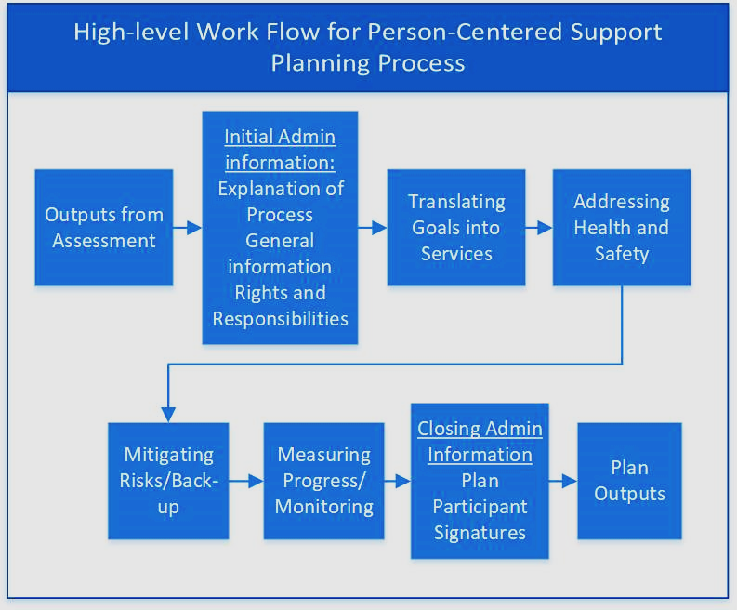
One More
Thing…
If time permits.
We should give some thought to constructing support plans.

Slide 49
Other Comments or Questions?

Slide 50
Presenter Contact Information
Alaska Division of Senior and Disabilities Services
Duane Mayes, Director Duane.Mayes@alaska.gov 907.269.3666
Colorado Department of Health Care Policy and Financing
Tim Cortez Manager, Community Options Section timothy.cortez@state.co.us 303.866.3011 Brittani Trujillo Case Management Services Coordinator brittani.trujillo@state.co.us 303.866.5567
HCBS Strategies, Inc.
Steven Lutzky, President steve@hcbs.info 410.366.4227

